Slide 1
SAM
Design Championship 2020
Industrial Design
Team Prayas

Slide 2
Technological superiority underpins our national military strategy, allowing us to field the most potent military forces by making best use of our resources, both economic and human

Slide 3
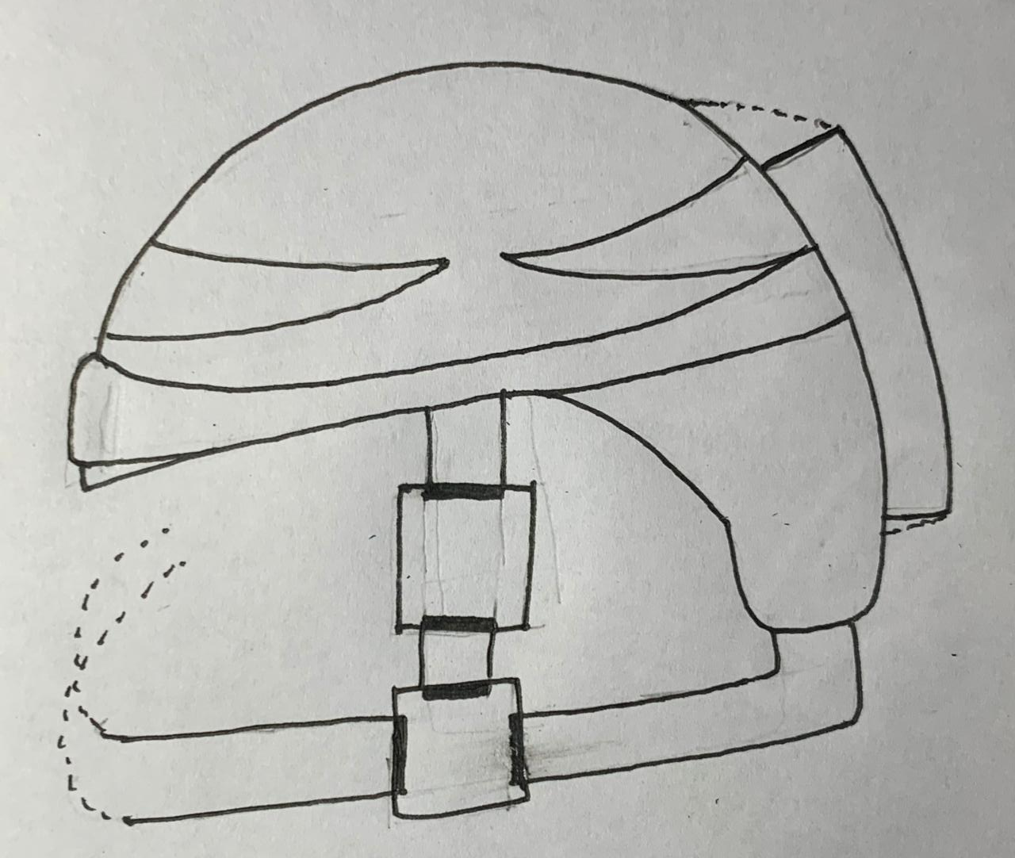
SAM
Keeping this quote in mind, SAM is a Smart Army Helmet packed with technically advanced peripherals for movement tracking, fall detection, path mapping, automatic illumination and strong enough to withstand the impact a bullet!

Slide 4
The Smart in SAM
With the advent of Technology in almost every sphere of our life, the military too needs to create an ecosystem which complements man, machine and technology.
Although intelligence gathering bases are quite the marvel, they are showing their age. The need of the hour is to create “Smart”, efficient and cost-effective solutions to these challenges.

Slide 5
Technological Prowess of SAM
Movement Tracking
Uses accelerometer sensors and programs to determine 360° motion and provides detailed time synced data.
Path Mapping
Carves out path followed along with distance covered, time taken and average speed for better coverage of remote locations
Lighting and Vision
Automatic front and rear illumination interfaced with inbuilt Real Time Clock for advanced vision and increased range of view.
Fall Detection
Can determine time of fall or collision using accelero gyro sensors and RTC
Power And Usage
Uses 11.1V 2200mah Battery to support all the Smart features of SAM for 2 days
Data-Security
Data is stored in an SD card and encrypted to prevent it from falling into enemy hands.

Slide 6
Structural Might
Adjustable Size
Chin Strap for stability
Night Vision via screen attachment
Strong build which can withstand the force of a bullet

Slide 7
Material of SAM
“SAM” is a Bulletproof Helmet along with many smart features to support the military services .The body of “SAM” would be built of Aramid fiber with a phenolic resin system. Aramid fiber is already being used in Aerospace and Military Applications.
The Features of Aramid Fiber include -:
Good Resistance to organic solvents and abrasion
Non-Conductive
Very High Melting Point (>500 °C)
Low Flammability

Slide 8
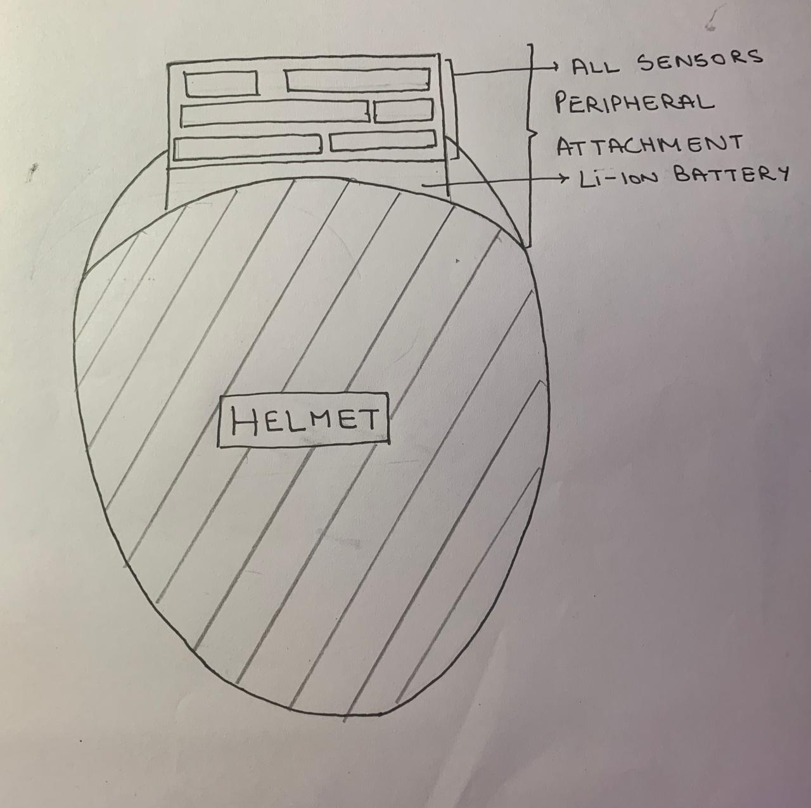
SAM Peripheral
Convert any helmet into a SAM helmet using this peripheral. All the technically advanced features can be used by just attaching this bullet-proof body onto a regular helmet.

Slide 9
Marketing
SAM can be used by the
Army - 2 million (India)
Firefighters - 55,000
Search and rescue ops
And much more..
For the safety of these heroic people,
SAM peripheral - INR 2000/-
SAM - INR 18000/-

Slide 10
Minimal Energy Consumption
SAM peripheral has been optimized to use minimal energy and hence last for a long duration of 3 days.
Keeping wastage in mind, any army helmet can be converted into SAM with the SAM peripheral hence saving time and effort

Slide 11
Thankyou!
“SAM”
~Team Prayas

Slide 12
TOP VIEW

Slide 13
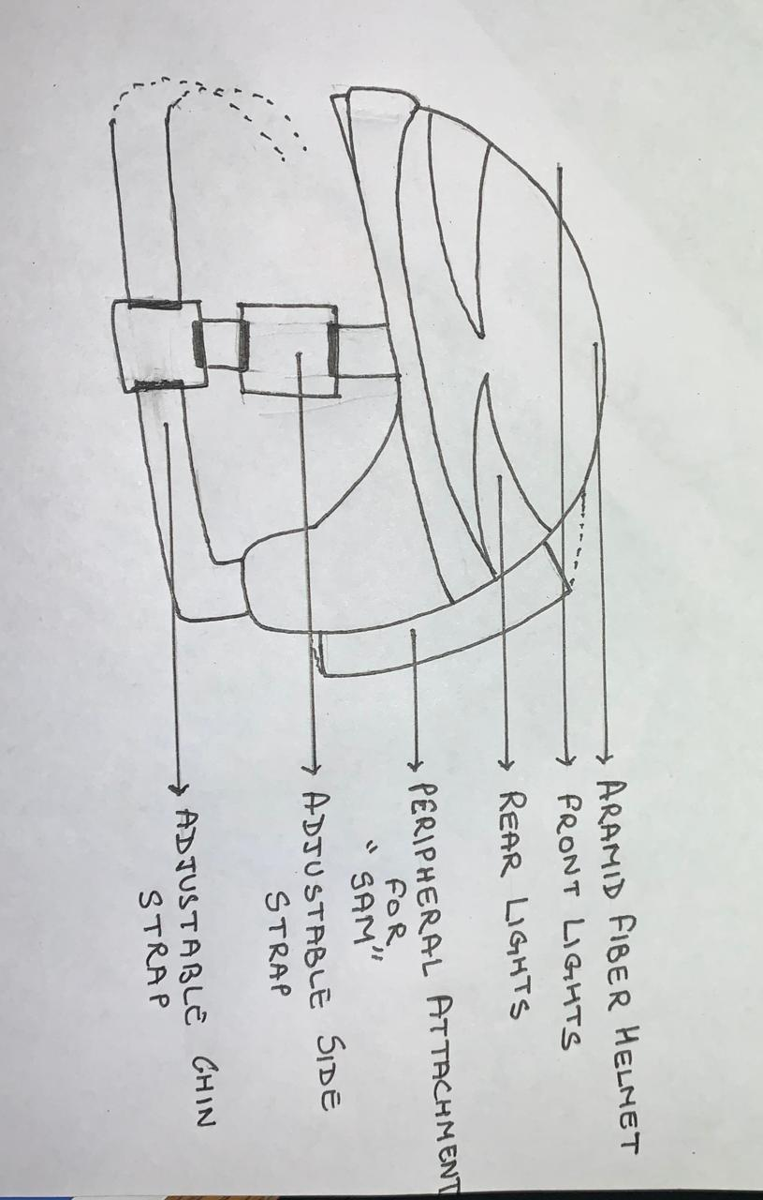
SIDE VIEW

Slide 14
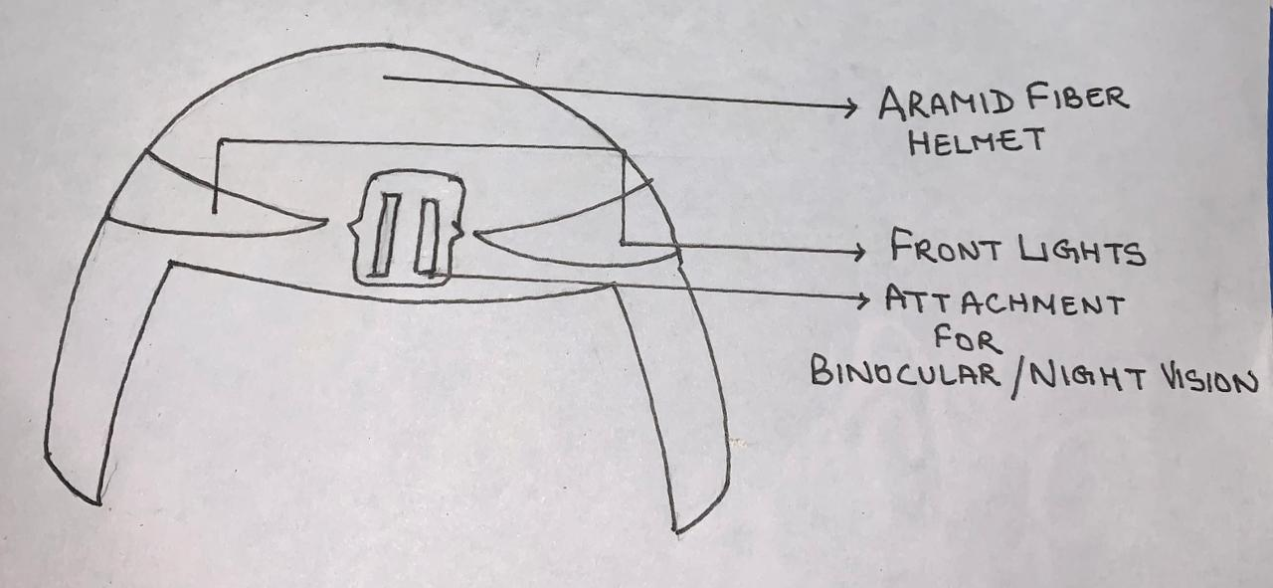
FRONT VIEW

Slide 15
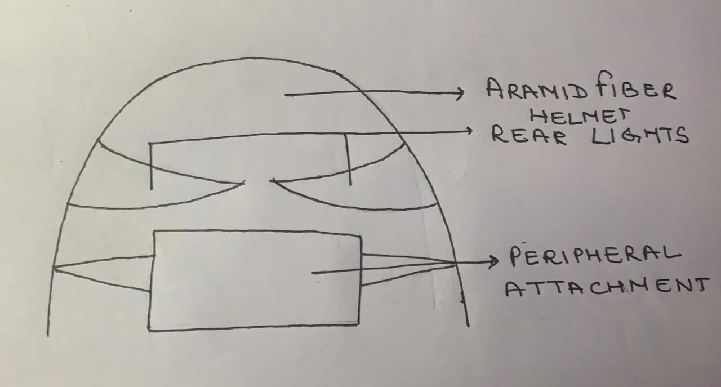
BACK VIEW

